Slide 1
SkyLand: Secure Landing Identification
AUTONOMOUS WORLD

Slide 2
Table of contents
01
02
03
04
05
06
Dataset
Data Processing
Unet
Semantic Drone Dataset
Visualization and Augumentation
Network Architecture
Unet Using Resnet
PSPnet Using Resnet
Landing Spot
Network Architecture Using Pretrained
Network Architecture Using Pretrained
Predict Potential Landing Spot

Slide 3
Dataset
What Dataset?
The Semantic Drone Dataset focuses on semantic understanding of urban scenes for increasing the safety of autonomous drone flight and landing procedures.
What Is The Data
A collection of 400 high-resolution images captured from altitudes between 5 to 30 meters above ground.
Different Class
Each image is annotated with segmentation masks, detailing 24 distinct classes such as paved areas, vegetation, vehicles, and obstacles.

Slide 4
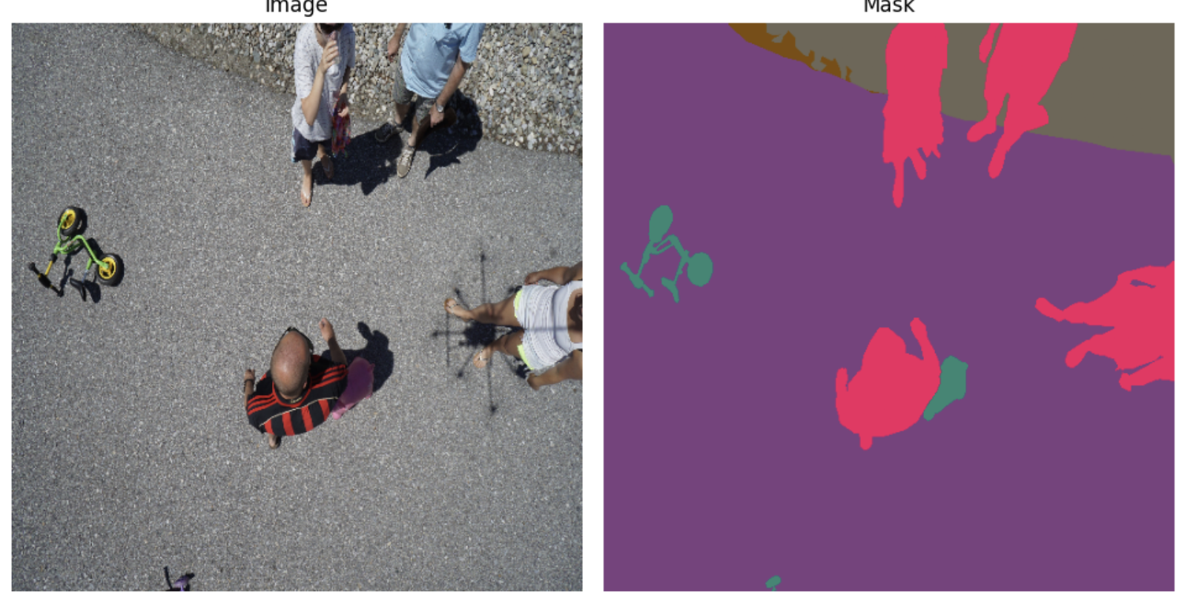
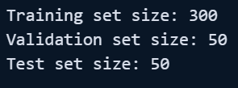
HOW DATA LOOKS
Train – Test Split

Slide 5
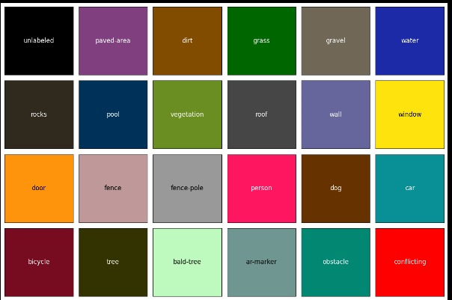
CLASSES

Slide 6
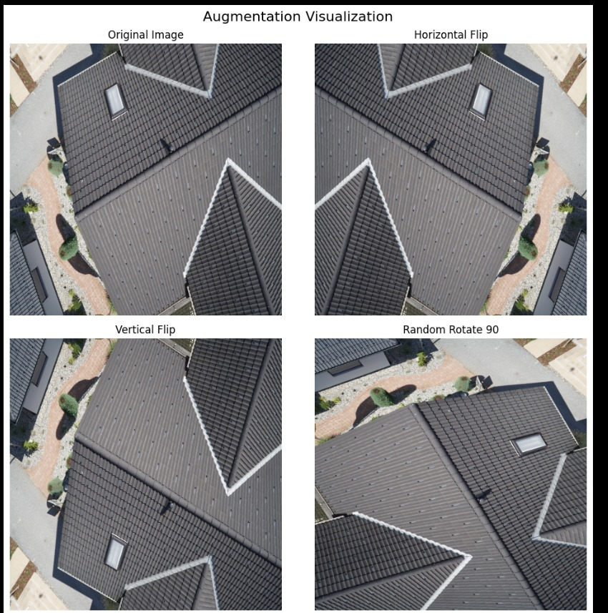
DATA AUGUMENTATION

Slide 7
UNET
UNET – RESNET
PSPNET - RESNET
Encoder – Decoder
Resnet For FineTuning
Capturing Context

Slide 8
U-NET
ENODER - DECODER

Slide 9
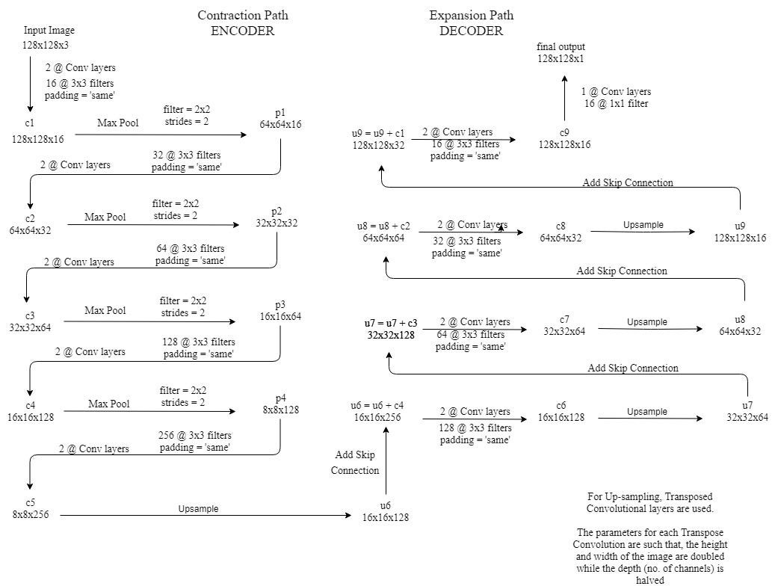
ARCHITECTURE

Slide 10
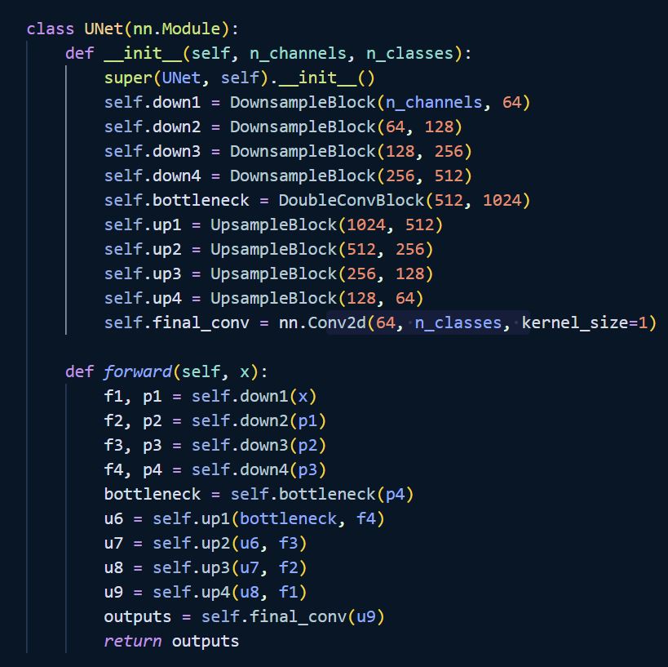
OUR UNET ARCHITECTURE

Slide 11
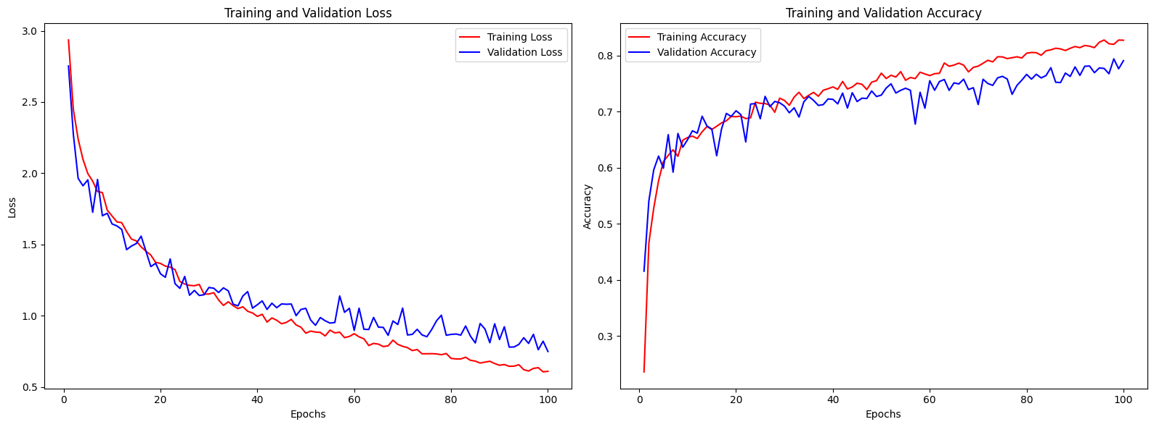
RESULTS

Slide 12
UNET - RESNET
FINE TUNING

Slide 13
Fine Tuning Pretrained Model “Use Knowledge Gained From One Problem, in a similar Problem”

Slide 14
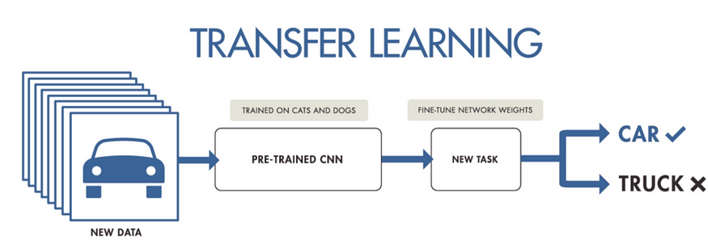
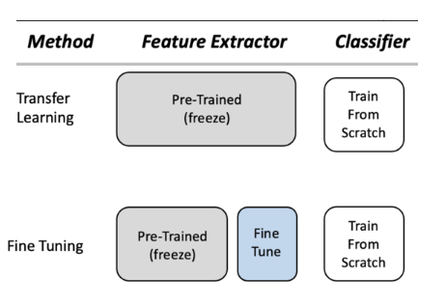
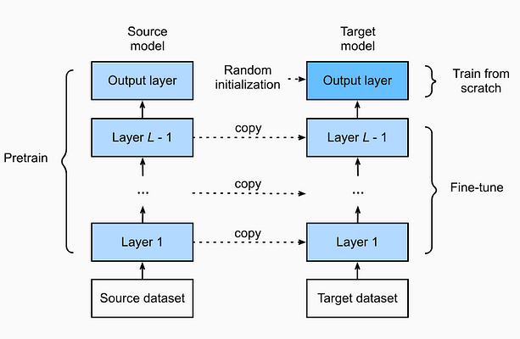
Transfer Learning
Technique where a model trained on one task (usually with a large dataset) is reused for a related but different task
Fine Tuning
Modifying and retraining a pre-trained model to fit a new, but similar, task. Typically, you take a pre-trained model (such as one trained on ImageNet) and continue training it on your new dataset

Slide 15
Step’s In Fine-Tuning A Model
Select a Pre-trained Model
Understand Model Architecture
Determine Fine-tuning Layers
Train the Model
Add Task-specific Layers
Freeze Pre-trained Layers
Configure Training Parameters
https://medium.com/munchy-bytes/transfer-learning-and-fine-tuning-363b3f33655d

Slide 16
Step’s In Fine-Tuning A Model
Select a Pre-trained Model
Understand Model Architecture
Determine Fine-tuning Layers
Train the Model
Add Task-specific Layers
Freeze Pre-trained Layers
Configure Training Parameters
https://medium.com/munchy-bytes/transfer-learning-and-fine-tuning-363b3f33655d

Slide 17
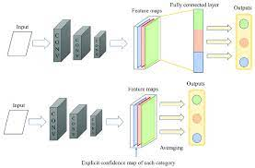
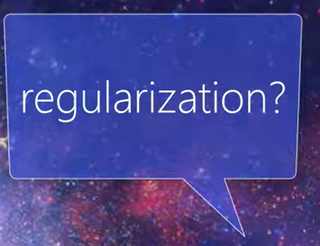
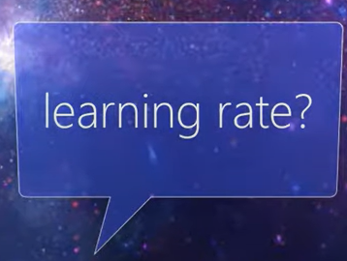
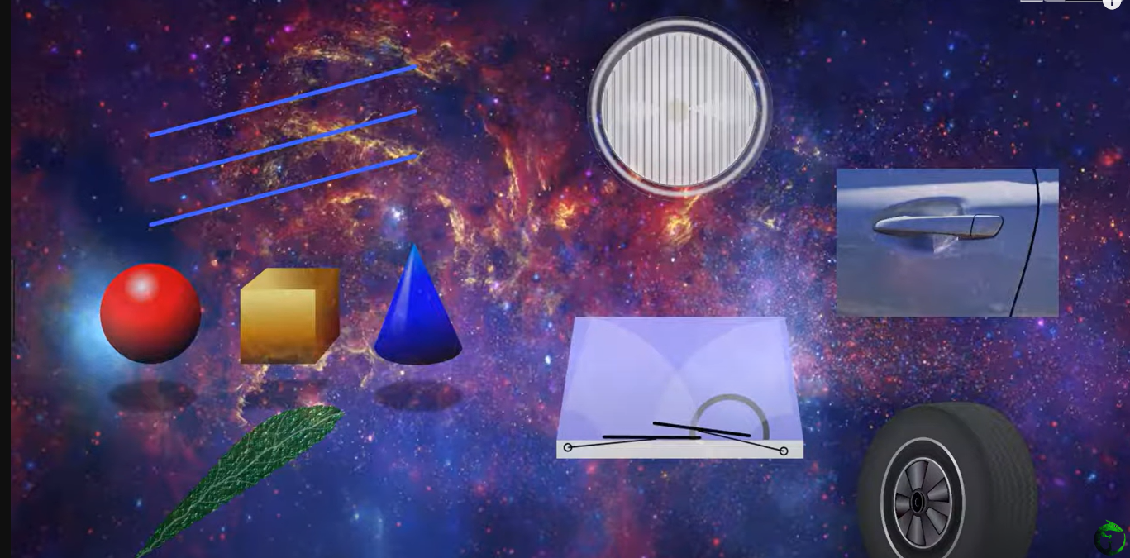
Problem With Defining Own Models

Slide 18
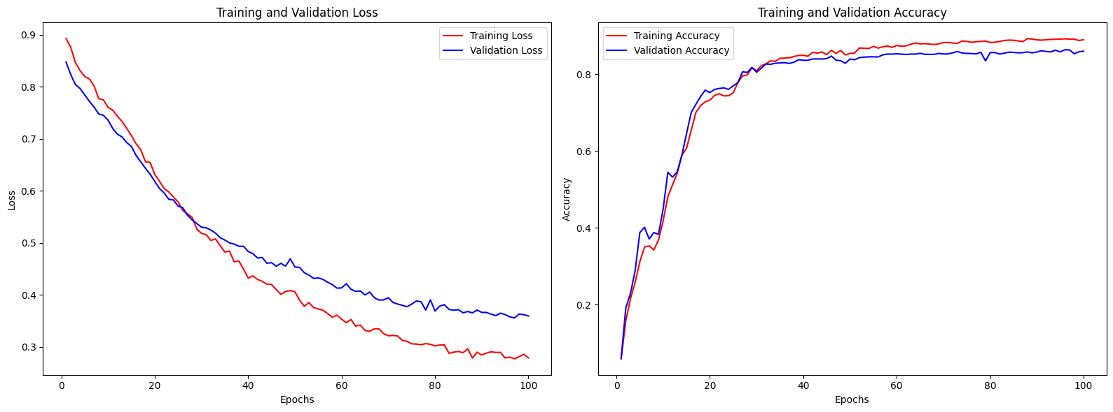
RESULTS

Slide 19
PSPNET - RESNET
FINE TUNING

Slide 20
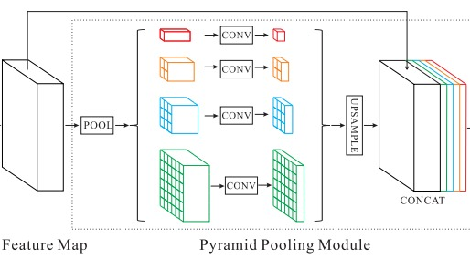
ARCHITECTURE

Slide 21


Convolution

Slide 22
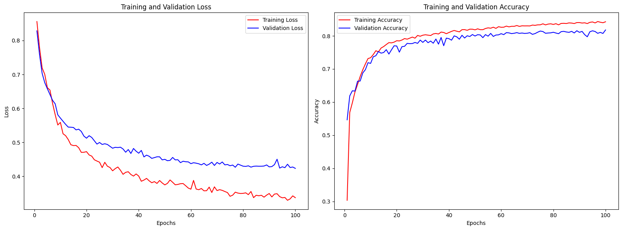
RESULTS

Slide 23
NOVELITY
FINDING THE OPTIMAL PATH FOR LANDING

Slide 24
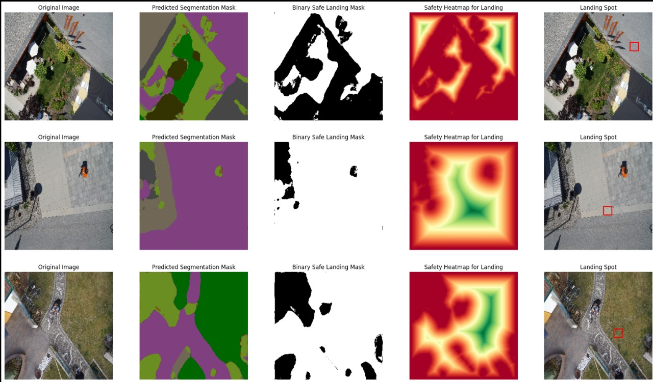
RESULTS

Slide 25
THANK YOU

